Slide 1
WALES

Slide 2
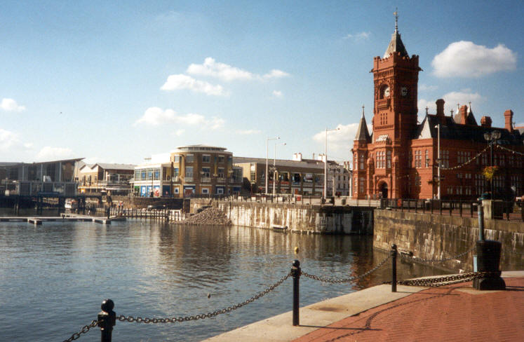
Wales is a region in the west of Great Britain. The national day of Wales is the Day of St David (March 1st ).Wales is a bilingual country. The two official languages are Welsh and English. The capital is Cardiff.

Slide 3
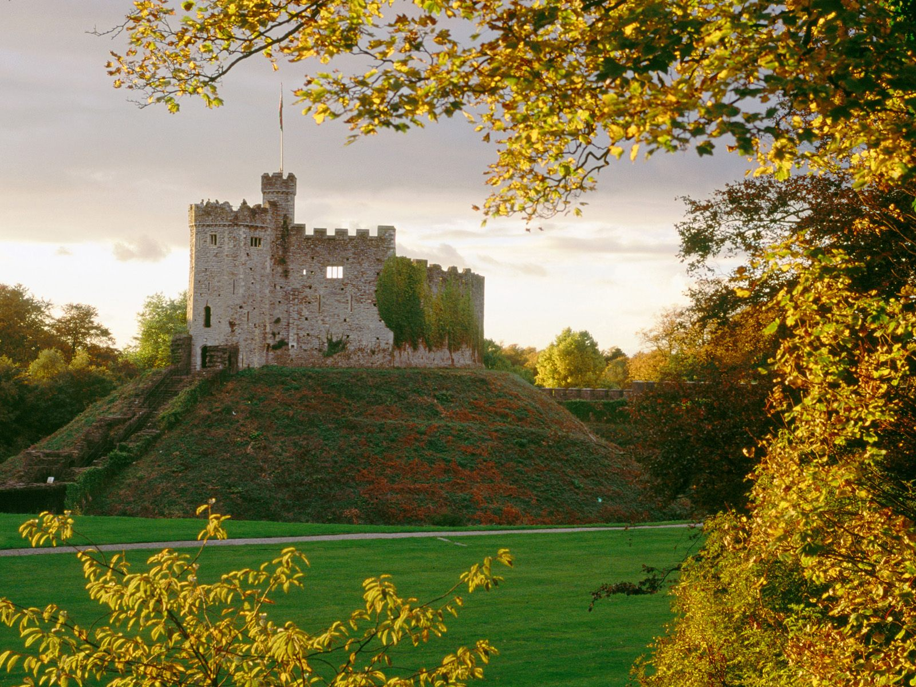
Cardiff Castle was built in 1091.The most famous occupant was Robert,Duke of Normandy.The castle was a Roman fort. Nowadays,some rooms of the castle can be used for weddings.

Slide 4
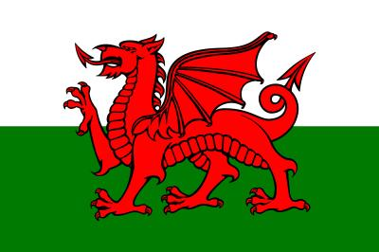
The Welsh dragon is a symbol of Wales. It appears on the flag of Wales and it can be a Roman mark of the colonization,whose army used dragons as standards. Henry VII took the symbol of King Cadwaladra,adding the colours green and white representing the House of Tudor ,on his way to the Battle of Bosworth. The leek and the narcissus are other important symbols of Wales.

Slide 5
QUESTIONS ABOUT WALES
1)What is the capital of Wales?
a)Cardiff.
b) Manchester
c) Liverpool
2) How many official languages are there in Wales?
a)English and Scottish.
b)American and Welsh.
c)Welsh and English.

Slide 6
THE ANSWERS ARE…
1)What is the capital of Wales?
a)Cardiff
2) How many official languages are there in Wales?
c)Welsh and English.

Slide 7
QUESTIONS ABOUT WALES
3) When is the national day of Wales?
a) St David’s day (March 1st).
b)St George’s day (April 23rd)
c) San Andrew‘s day (November 30th).
4)When was the castle built?
a)1191
b)1080
c)1091

Slide 8
THE ANSWERS ARE…
3) When is the national day of Wales?
a) St David’s day (March 1st ).
4)When was the castle built?
c)1091

Slide 9
QUESTIONS ABOUT WALES
5) What was the castle?
a) a Roman fort.
b) an abandoned castle.
c) a damned castle.
6) For what can their rooms be used now?
a) for tourists.
b)for political meetings.
c) for weddings.

Slide 10
THE ANSWERS ARE…
5) What was the castle?
a) a Roman fort
6) For what can their rooms be used now?
c) for weddings.

Slide 11
QUESTIONS ABOUT WALES
7) What animal and what colour appear on the flag of Wales?
a) Red dragon.
b) Green salamander.
c) Golden tiger.
8) What other symbols represent Wales?
a)The cat and the lilac
b) The leek and the narcissus
c)The dog and the tulip

Slide 12
THE ANSWERS ARE…
7)What animal and of what color is the Welsh symbol?
a) Red dragon.
8) What other symbols represent Wales?
b) The leek and the narcissus

Slide 13
LUCÍA GARZÓN MIGUEL
MARÍA MANGAS SASTRE
BEATRIZ MARTÍN GARCÍA

